Slide 1
Minerva’s List
Adrian Escobar & Alexander Hubbard
Minerva’s List
2026

Slide 2
Contents
Company Name
Date
Why?
Slide 03
01
What?
Slide 04
02
Who?
Slide 05
03
Q&A
Slide 06
04

Slide 3
Why this idea
Minerva’s List
2026
UNCG fosters community that is filled with creative people. These students create, but their products float without a home.

Slide 4
What this app plans to solve
Minerva’s List
2026
01
02
03
Offer one platform for students to cell products and services
Authorize only uncg accounts in order to hold sellers accountability
Allow ratings and reviews to help gauge sellers and quality

Slide 5
Who is this for?
Minerva’s List
2026
All UNCG students!

Slide 6
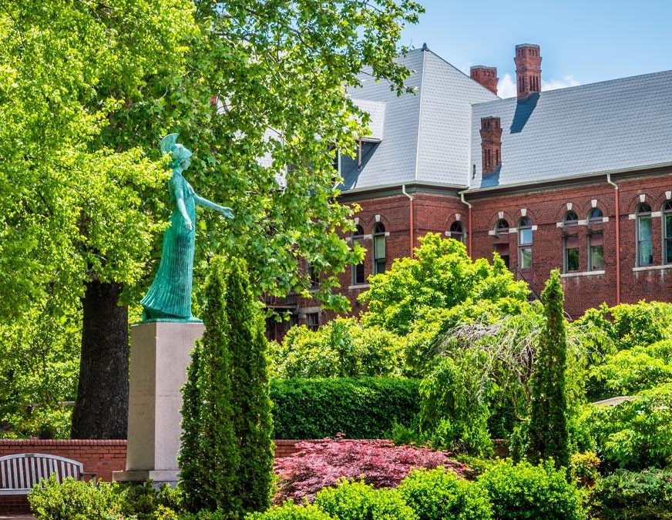
Minerva’s List
2026
Q&A
Any questions? Ask away!
‹#›

